Slide 1

The battle of neighborhood
- By Bhavana Inguva Venkata Sai

Slide 2
INTRODUCTION
This is a list of postal codes in Canada where the first letter is M.
Postal codes beginning with M are located within the city of Toronto in the province of Ontario.
Only the first three characters are listed, corresponding to the Forward Sortation Area.

Slide 3
DATA
List of postal codes of Canada with M: https://en.wikipedia.org/wiki/List_of_postal_codes_of_Canada:_M
Using Foursquare API to get the following
List of all venues in each Locality within Toronto.

Slide 4
METHODOLOGY
The Wikipedia page https://en.wikipedia.org/wiki/List_of_postal_codes_of_Canada:_M was scraped using the BeautifulSoup library to build a pandas dataframe listing the locations in Toronto.
The Foursquare API is the used to get the venues in Toronto.

Slide 5
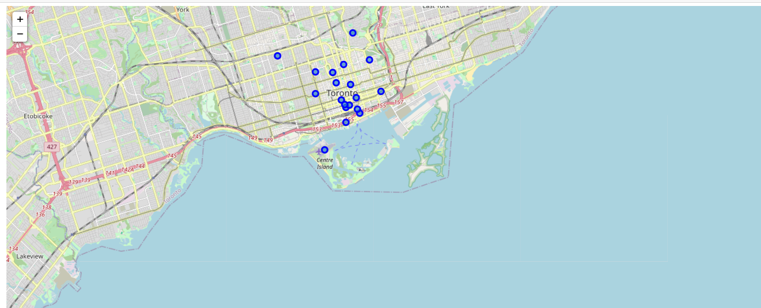
A MAP OF DOWNTOWN TORONTO USING LATITUDE AND LONGITUDE VALUES

Slide 6
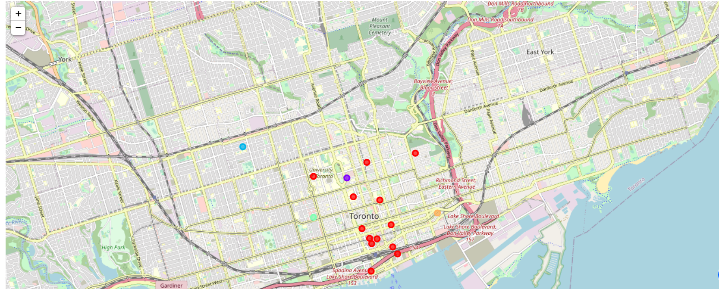
MAP OF CLUSTER LABELS

